Slide 1
STEMI Strategus package
Instructions on how to run
Milou Brand

Slide 2
What is Strategus?
Strategus Module is an R Project that acts as a lightweight wrapper around one or more HADES packages. It has the following responsibilities:
Declaring a renv.lock file for all R dependencies
Providing functions for defining the module settings to store in the analysis specification JSON
Implement an “execute” function to perform the analytical tasks based on module settings JSON using HADES packages
Writing results as CSV files for sharing across the OHDSI network
For this project, the package has been completely set-up for execution by IQVIA, so no need to change anything in the settings.R file. All you need to do is follow the instructions in the following slides and run the CodeToRun.R file.

Slide 3
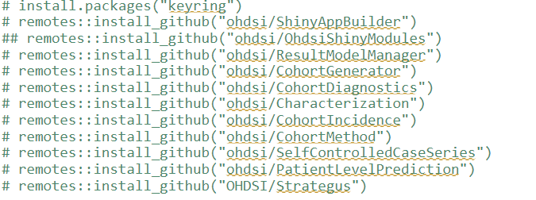
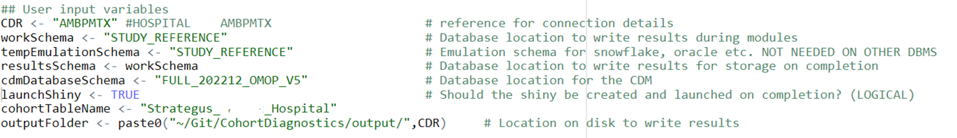
CodeToRun.R
Make sure you install all the packages stated at the top of the file. Please note, the list might be shorter than this
Enter all these variables with your institution’s specific database details

Slide 4
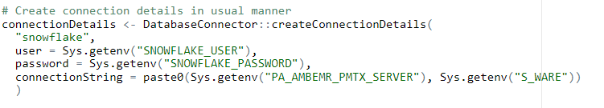
CodeToRun.R
Enter your institution’s database connector details
If you have used Keyring before in the specific R server, for example if you participated in the SOS Challenge or HowOften study, please enter your keyring password here: Sys.setenv(STRATEGUS_KEYRING_PASSWORD=“….")
If you haven’t used keyring yet, set a secret keyring password.
For example, Sys.setenv(STRATEGUS_KEYRING_PASSWORD=“empace")

Slide 5
Keyring
If Keyring:: or secretservice errors occur, first please ensure that: Run in a terminal the following before installing keyring (may be different depending on linux flavour) for reference Keyring Secret handling:
sudo yum install libsodium libsodium-devel
sudo yum install libsecret libsecret-devel
sudo chmod 777 /home/idies/.config

Slide 6

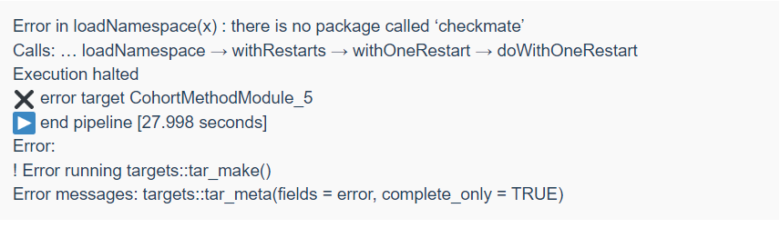
CodeToRun.R
Once you run:
Strategus will unpack and install each package that is needed in:
Sys.setenv(INSTANTIATED_MODULES_FOLDER="~/StrategusModulesHome") – please change directory if needed
Sometimes when executing the package will tell you that certain packages have not been installed. Please follow the steps on the next slide to solve this problem.
See example error message:

Slide 7
Other things to note
Problem solving
Open the project (e.g., CohortDiagnosticsModule_0.1.0) and it should automatically prompt you to restore the renv and install all packages. If it doesn’t, please run renv::restore() for each module in the StrategusModulesHome directory to ensure all packages have been installed.
If you still encounter problems, it could be that you will need to open the project in the specific module in the StrategusModulesHome directory and install the relevant packages there.

Slide 8
Viewing results
And the shiny app results
Please run results_compile.R to compile the results for viewing
To view your results, run the app.R and a shiny should appear with the results, where you can evaluate your database’s results

